Slide 1
Predicting Credit Card Default in Taiwan
IS5740, Semester A 2023/2023
TO BE DECIDED
Wu Yifei, 58243516
Wu Shengjun, 58065781
Wong Tsz Yiu, 58218046
Guanze Chen, 58155621
Guan Yanying, 58000752
YU Xinyu, 58188431
ZHAO Yisong, 57965957

Slide 2

Our project aims to assist financial institutions:
Effective Risk Management
Make informed lending decisions
Approaches:
Building a model that can predict credit card
defaults accurately of clients in Taiwan.

Slide 3

- Why is it important to solve the problems? - How can the results be applied to solve the business problems?
Effective Risk Management & Informed lending decision
If the banks are able to identify high-risk clients, they can reduce these potential cost by:
1. Early intervention: providing timely reminders and offering financial counseling services.
2. Taking Proactive measures: lowering their credit limits or offering at a stricter term.
These measures help reduce the risk of default, mitigate the impact of defaults and lower the bank's exposure to potential financial losses.
For low-risk clients, offer them a better commercial term and better customer service.
Notes:
Since Defaulting clients can result in significant financial losses, due to the unpaid debts and administrative costs associated with collections.
If the banks are able to identify high-risk clients, they can reduce these potential cost by:
1. Early intervention: providing timely reminders and offering financial counseling services.
2. Taking Proactive measures: lowering their credit limits or offering at a stricter term
These measures help reduce the risk of default, mitigate the impact of defaults as well as lowering the bank's exposure to potential financial losses.
Low-risk clients: offer them at a better commercial terms and better customer service

Slide 4
Data Exploration: dataset contain info. about client in TW
There are in total 30,000 observations and 24 attributes (including TARGET)
Attributes Name | Description
SEX | Gender (1=male, 2=female)
EDUCATION | (1=graduate school, 2=university, 3=high school, 4=others)
MARRIAGE | Marital status (1=married, 2=single, 3=others)
AGE | Age in years
CREDIT_LIMIT | Amount of credit limit in NT dollars
PAY_1 | Repayment status in September 2005 (0=pay duly, 1=payment delay for one month, 2=payment delay for two months, … 9=payment delay for nine months and above)
PAY_X (2 to 6) | Repayment status in August to April 2005 (scale same as above)
BILL_AMT_1 | Amount of bill statement in September 2005 (NT dollar)
BILL_AMT_X (2 to 6) | Amount of bill statement in August to April 2005 (NT dollar)
PAY_AMT_1 | Amount of previous payment in September 2005 (NT dollar)
PAY_AMT_X (2 to 6) | Amount of previous payment in August to April 2005 (NT dollar)
DEFAULT_NEXT_ MONTH | Default Status in October 2005 (1=yes, 0=no)
Demographics information
Independent
variables
Client's Credit Card usage info during Apr to Sep 2005
TARGET
(Oct 2005)

Slide 5
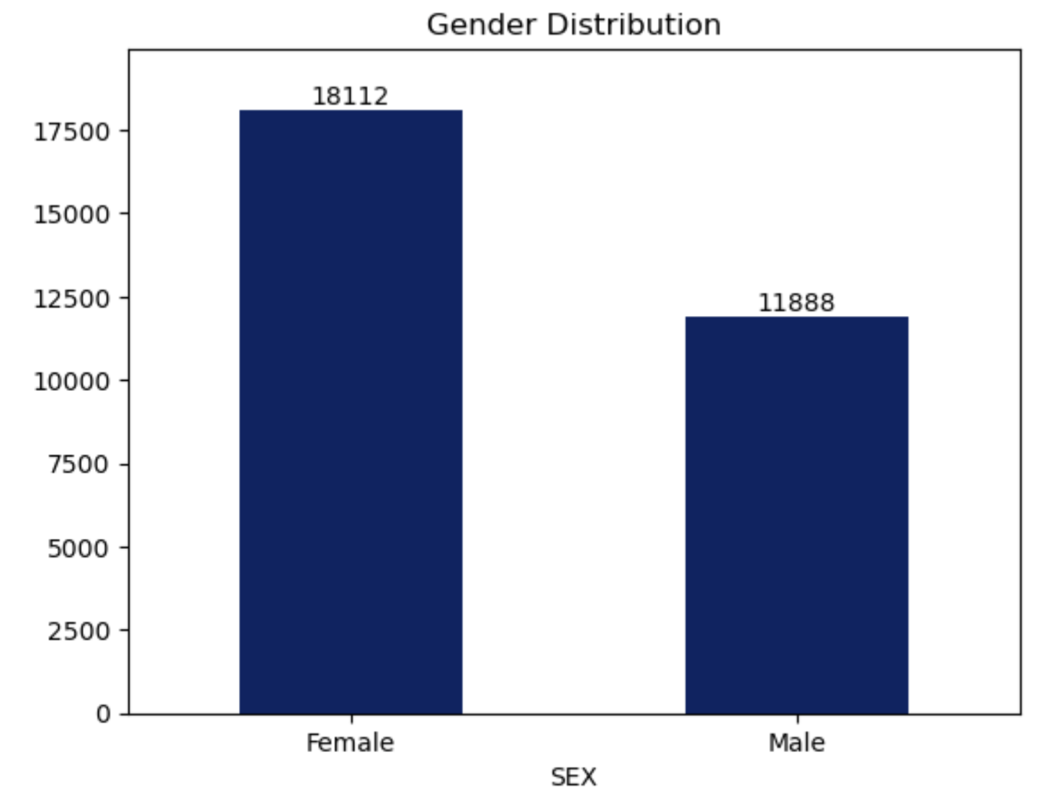
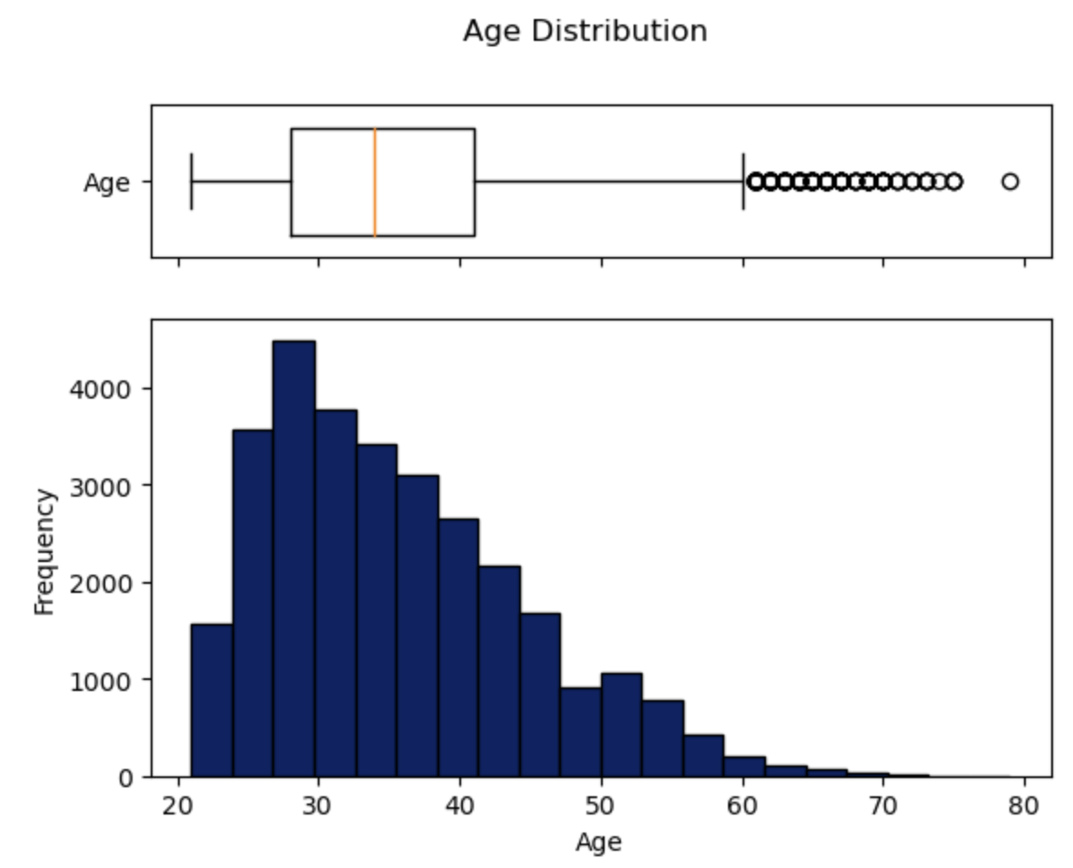
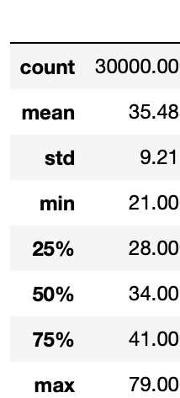
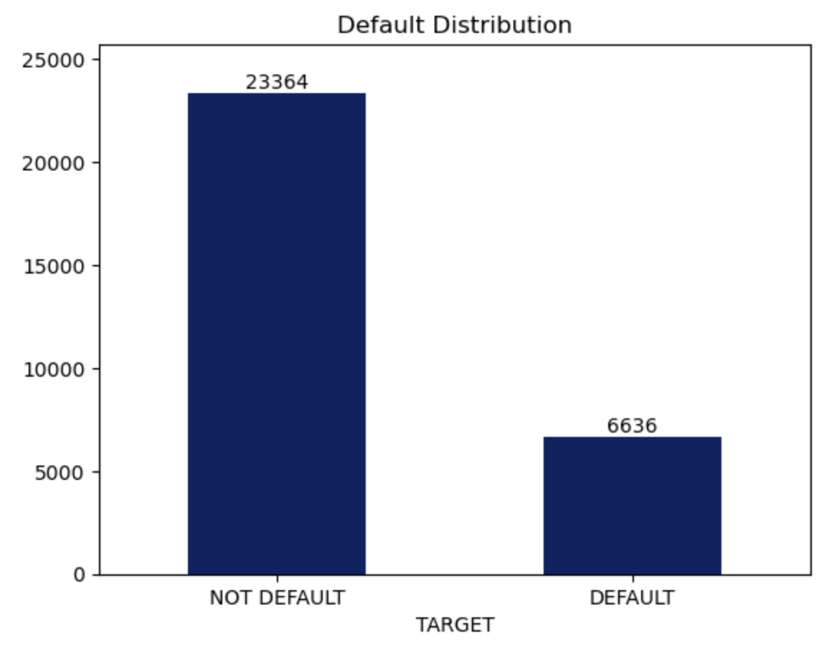
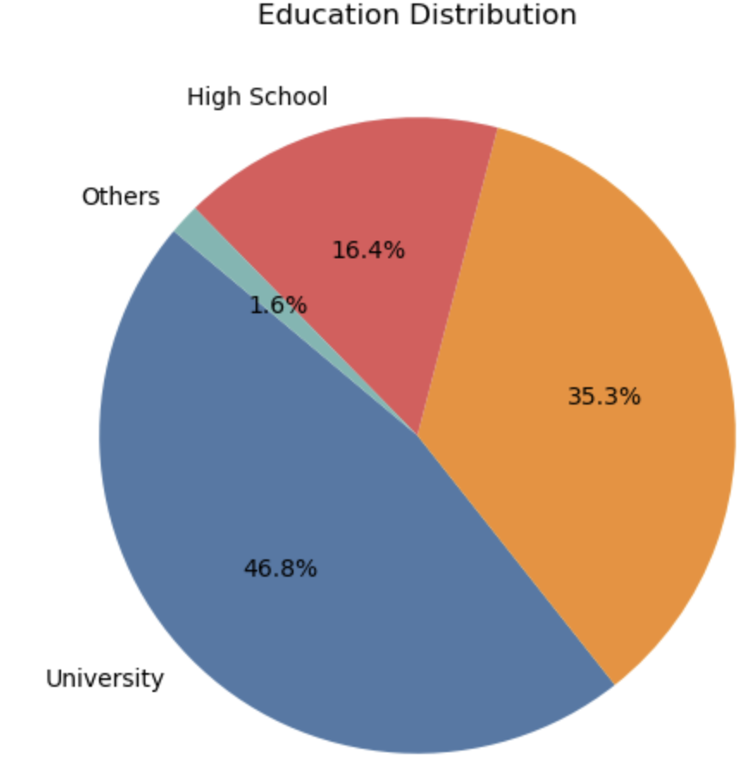

Preliminary Descriptive analysis
TARGET
AGE
60%
40%
78%
High Sch
22%
Graduate
Default (1) | 23,364
NOT Default (0) | 6,636
Default Percentage | 22.12%
University

Slide 6
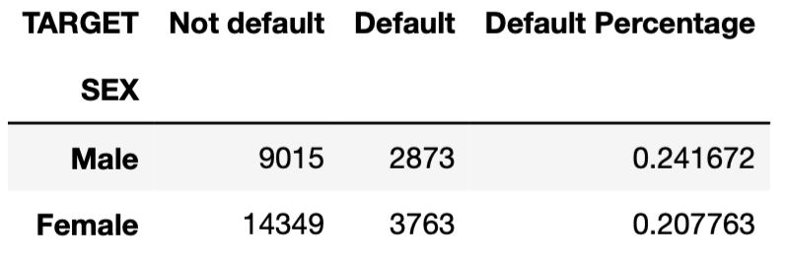
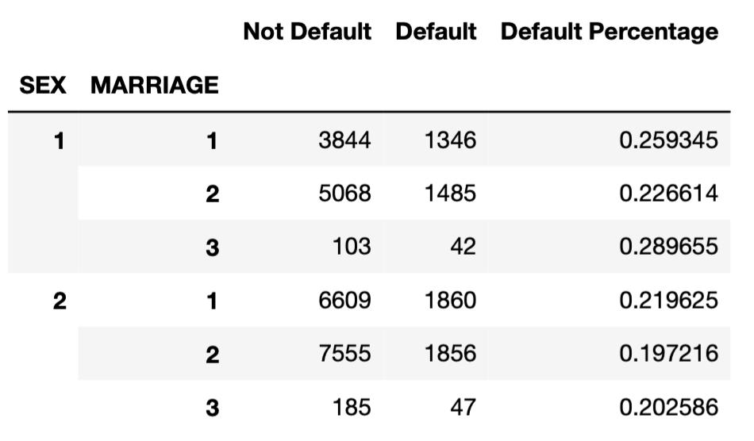
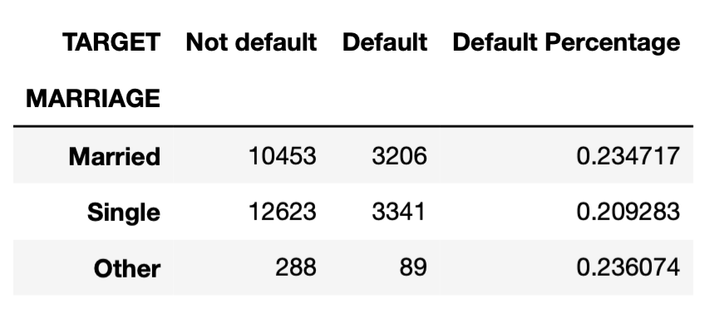
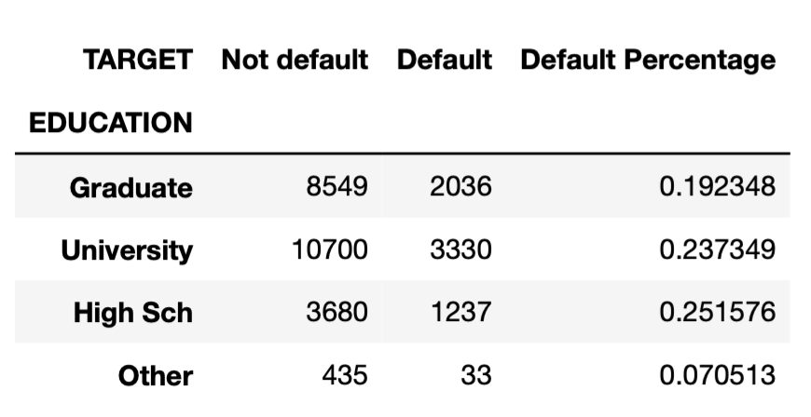

Gender
Given the average default rate of 22.12%...
PIVOT TABLE
Marital
Status
“Naive” insight from the above pivot table:
- Seems Married Men has a HIGHER default
- Seems Single Women has a LOWER default
(than the average, just by ONLY looking at
these two attributes)
Educat-
ion
Default

Slide 7
Identified Problems and Approach
Problem 1: How to build a model that can predict client defaults on credit card accurately?
Problem 2: How do various attributes impact the likelihood of default?
Further Data
Exploration
Data Preprocessing
ML Model
Building
Binary Classification
- Logistical Regression
- Decision Tree
- Neural Network
Accuracy: BASELINE
Sensitivity, Specificity
F1 score
AUC-ROC
Evaluate Model performance
Fine-tuning Model parameters

Slide 8


